Slide 1
Digging Into your APIs with Exploratory Testing
Amber Race (@ambertests) Senior SDET, Big Fish Games

Slide 2

Introduction

Slide 3
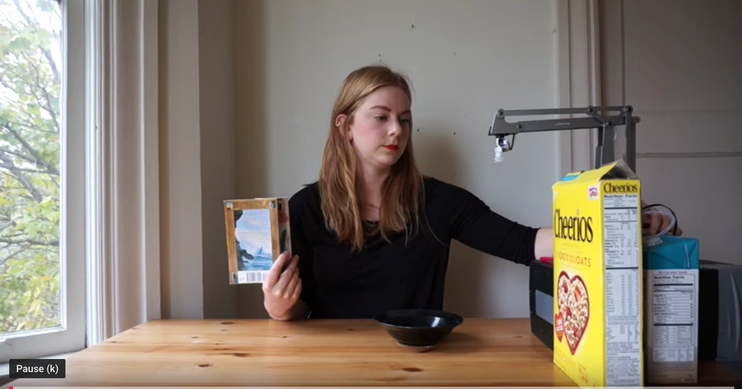
Why Test at the Service Level?

Slide 4

Exploratory Testing
Testing without a pre-set script or set of test steps.

Slide 5

Postman
www.getpostman.com

Slide 6
Exploring Service APIs In The Wild

Slide 7
Spotify API
https://developer.spotify.com/console
Get a generic token
Use the Search API to get ids for artists, etc
Use those ids to get more info

Slide 8
Task #1
Use the Spotify web console to find the name, release date, and length of the top track by your favorite artist.
Find out the top track of that artist in Japan (JP)

Slide 9
Getting Data into Postman
Open Developer Tools
Do things
Right click the service calls (XHR)
Copy as cURL
Paste into Postman: Import Raw Text
The same method works in Charlesproxy!

Slide 10
Task #2
Go to Amazon and find the api which shows products based on your search
Pull into Postman and determine the minimum number of parameters needed to make the call

Slide 11
RESTFUL Booker

Slide 12
Get Yer Samples!
All code shown in this talk is available on my Github!
https://github.com/ambertests/explore-with-postman

Slide 13
How to Run Restful Booker Locally
Get the code from https://github.com/mwinteringham/restful-booker
Run ‘npm install’ (requires Node.js)
Run ‘npm start’
Service runs on http://localhost:3001
Or use the mirror site: http://amber-booker.herokuapp.com

Slide 14
Task #3
Load the RestfulBooker Codemash collection into Postman
Set up an one or more environments, either to the main site, the mirror, or your local host
Update the collection to use Environments

Slide 15

Service Test Strategy
P – Parameters
O – Output
I – Interop
S – Security
E – Error Handling
D – Data

Slide 16
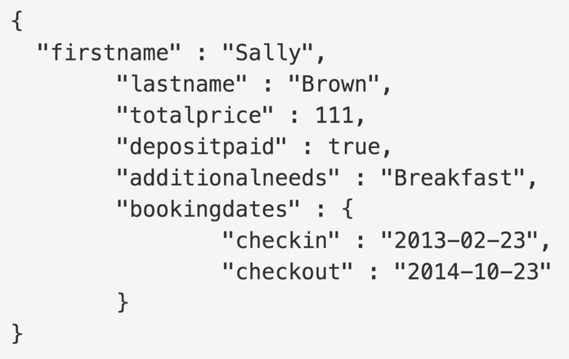
Parameters
The client is always wrong
Boundaries
Business rules

Slide 17
Task #4
Find at least 5 instances in Restful Booker where parameters are not properly validated
Bonus: Discover how you can make a booking with a null value for the name

Slide 18
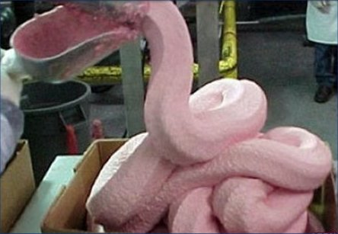
Output
Status codes
Headers
Logging

Slide 19
Task #5
Get Restful Booker to tell you it is a teapot

Slide 20

Interop
Clients
Dependencies

Slide 21
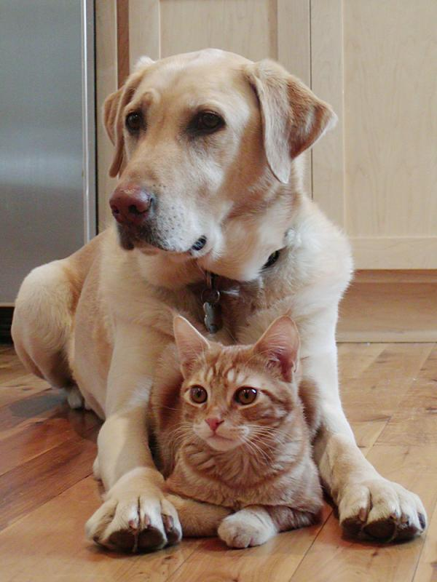
Security
Authentication and spoofing
Exposed data
SQL Injection
“Hidden” apis

Slide 22
Setting up BurpSuite
Open http://ambertests-juiceshop.herokuapp.com
Open a temp project in BurpSuite using defaults
In the target tab, clock Paste URL to limit the scope
In the Proxy tab, go to Options
Export the certificate and install locally – be sure to fully trust it!
Set your browser proxy to the same port as Burp
Go to the Intercept tab and turn it off
Let the spice flow

Slide 23
Using Burp to do a SQL attack
Select the login request and send to Intruder
Use Sniper attack
Limit attack to just the email field
In payloads, select some injection attacks from FuzzDB and paste them into the Payload options (https://github.com/fuzzdb-project/fuzzdb/blob/master/attack/sql-injection/detect/xplatform.txt)
Start Attack

Slide 24
Task #6
Find the admin login credentials using the BurpSuite Intruder, FuzzDB, and the passwords listed here: https://github.com/ambertests/explore-with-postman/blob/master/csv/passwords.csv
(Hint, the password starts with “A”)

Slide 25
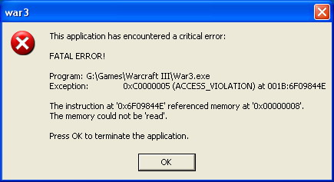
Exceptions
No unhandled exceptions
Error info, but not too much

Slide 26
Task #7
Find an instance in Restful Booker where an error causes data corruption

Slide 27

Data
Updates and replication
Unicode
Caching

Slide 28
Task #8
Load the GraphQL collection into Postman
Create a new user and the get it back out

Slide 29
Resources
Restful Boooker: https://restful-booker.herokuapp.com
Workshop materials: https://github.com/ambertests/explore-with-postman
FuzzDB: https://github.com/fuzzdb-project/fuzzdb
OWASP Juice Shop: https://www.owasp.org/index.php/OWASP_Juice_Shop_Project
GraphQL: https://graphql.org
GraphQL Example: https://github.com/claudiajs/example-projects/tree/master/graphql-example

Slide 30

Thank you for attending!
Email: amber.race@outlook.com
LinkedIn: https://www.linkedin.com/in/amber-race-tests
Twitter: @ambertests

